Slide 1
DATA SCIENCE
UNIT II
ANOVA
From: Business Analytics, Web resources

Slide 2
Contents
Introduction
Types of ANOVA
ANOVA Procedure
One way ANOVA
Two way ANOVA
Application

Slide 3
Introduction
ANalysis Of VAriance (abbreviated as ANOVA)
ANOVA is a statistical test for estimating how a quantitative dependent variable changes according to the levels of one or more categorical independent variables.
ANOVA tests whether there is a difference in means of the groups at each level of the independent variable.
This technique is used when multiple sample cases are involved.
The ANOVA technique enables us to perform to examine the significance of the difference amongst more than two sample means at the same time.
Applications : Fields of economics, biology, education, psychology, sociology, business/industry and in researches of several other disciplines.

Slide 4
Types of ANOVA
ANOVA is two types
One way ANOVA :
only one factor is investigate
    one independent variable (with 2 levels)
    Analysis of Variance could have one independent variable
Two Way ANOVA :
investigate two factors at the same time.
    two independent variables (can have multiple levels).
    Analysis of Variance has two independent variables.
    Two way ANOVA without replication
    Two way ANOVA with replication

Slide 5
Principle of ANOVA
The Principle of ANOVA (Analysis of Variance) is based on the idea that the total variation observed in a dataset can be divided into two components:
Variation between groups (Treatment Variation):
Variation caused by the differences among the means of different groups.
2. Variation within groups (Error or Residual Variation):
Variation caused by random factors or natural differences among observations within the same group.
ANOVA tests whether the differences between group means are statistically significant by comparing these two sources of variation.
The test statistic is the F-ratio, which compares the between-group variation to the within-group variation.
F = Variance based on between samples variance
Variance based on within samples variance
This value of F is to be compared to the F-limit for given degrees of freedom. If the F value we work out is equal or exceeds the F-limit value.

Slide 6
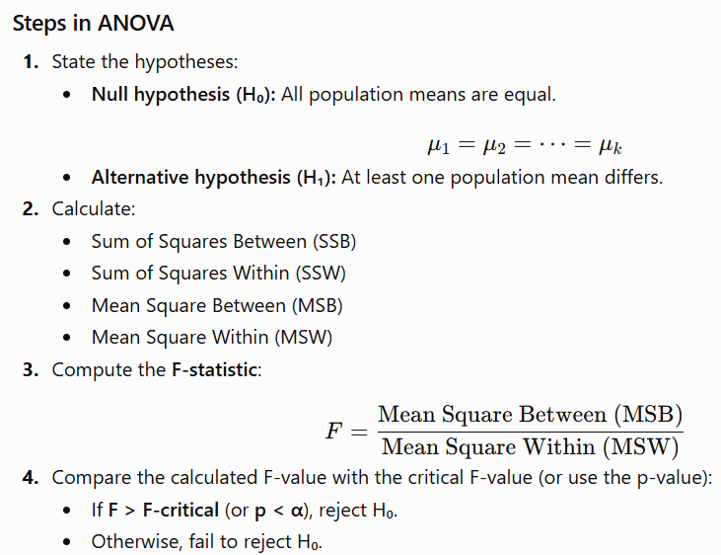
ANOVA procedure

Slide 7
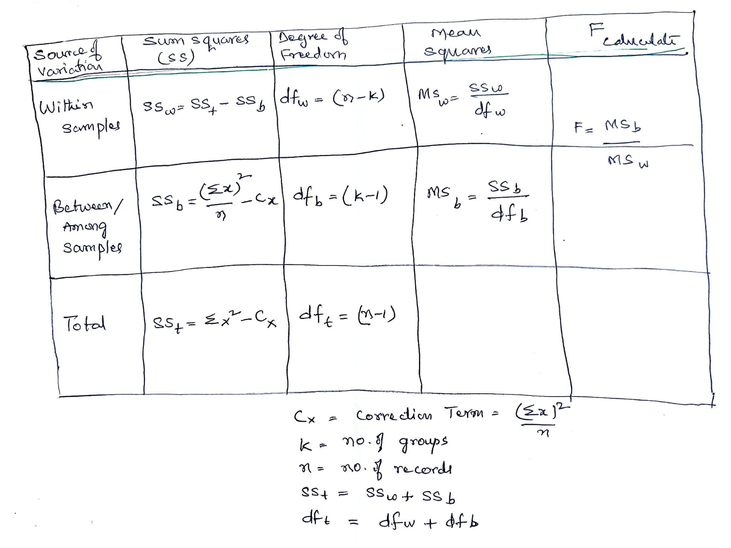
One-way ANOVA formula

Slide 8
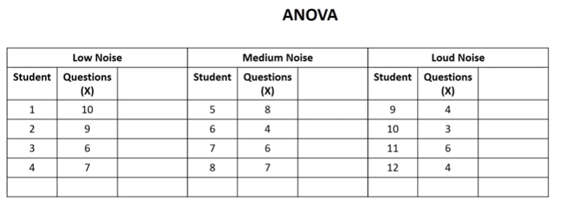
Example 1: Data related to no. of questions solved in different types of noises.
Find the significance of the noise on solving questions
k: No of groups=3
n: No. records= 12
Null hypothesis Ho: There is no significance of noise in writing questions

Slide 9
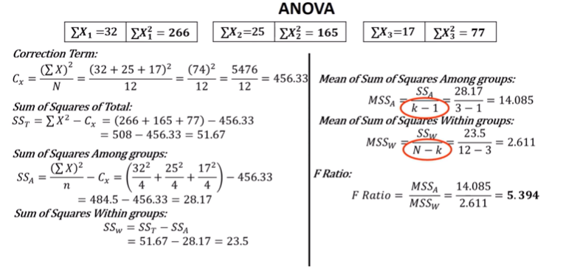
Example

Slide 10
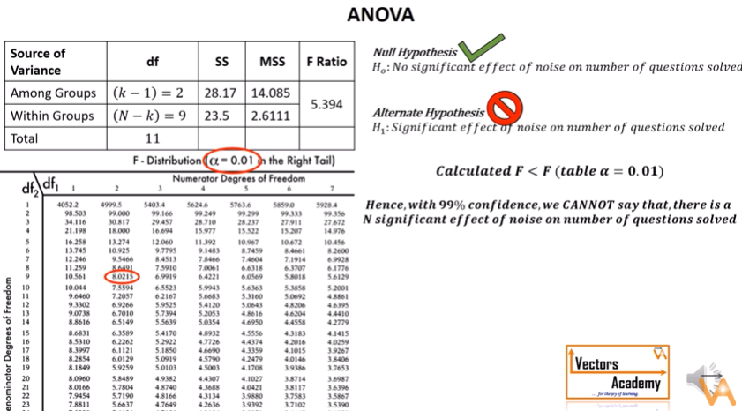
Example

Slide 11
Example -2
Set up an analysis of variance table for the following per acre production data for three varieties of wheat, each grown on 4 plots and state if the variety differences are significance.
Plots of land | per acre production data
 | variety of wheat
 | A | B | C
1 | 6 | 5 | 5
2 | 7 | 5 | 4
3 | 3 | 3 | 3
4 | 8 | 7 | 4

Slide 12
Table :
Example 2 Answers
one way anova
d.f. MS
5% F-
limit(from the f ratio table)
Source of SS variation
f- ratio
Between 8 sample
(3-1)= 2
8/2 = 4
4/2.67=
1.5
F(2,9)= 4.26
Within
Sample
24
(12-3) = 9
24/9 =
2.67
Total
32
(12-1) =
11

Slide 13
Conclusion
The above table shows that the calculated value of F is 1.5 which is less than the table value of 4.26 at 5% level with
d.f. being v1 = 2 and v2 = 9 and hence could have arisen due to chance.
This analysis supports the null-hypothesis of no difference is sample means.
The difference in wheat output due to varieties is insignificant and is just a matter of chance.
It means that the varieties is not so much differ from each other

Slide 14
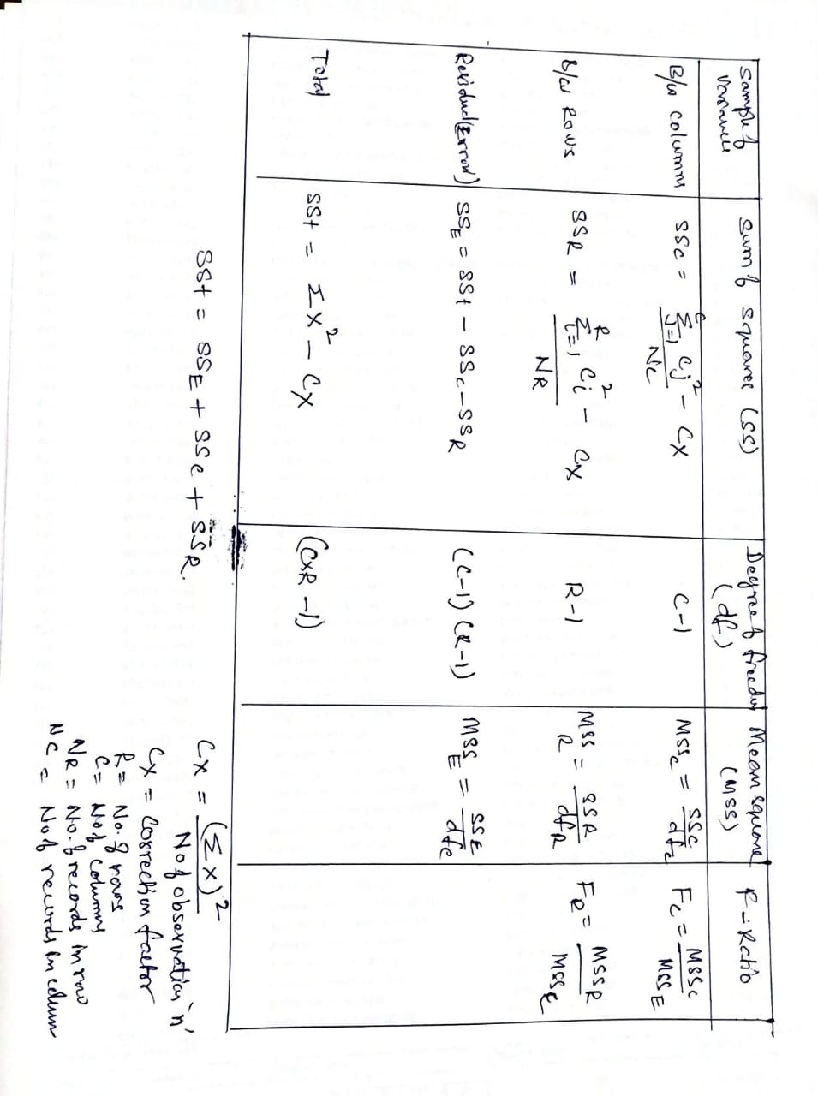
Two-way ANOVA- without replication formula

Slide 15
Example -1 Set up an analysis of variance table for the following two- way design results: Does the varieties of seeds significant to production. Does the varieties fertilizers significant to production.
Assume: Null hypothesis: No significance
Two-way ANOVA- without replication : Example
 | per acre production data
 | Varieties of seeds
Varieties of fertilizers | A | B | C
W | 6 | 5 | 5
X | 7 | 5 | 4
Y | 3 | 3 | 3
Z | 8 | 7 | 4

Slide 16
Step1 : Obtain the total value of individual
Total = sum of all individual
= 6+7+3+8+5+5+3+7+5+4+3+4
=60
so we have T= 60 and n = 12
Where
T = sum of all individual sample
N = number of sample
Step 2 : calculate correction factor
Correction factor = Square of total value / number of sample So correction factor Cx= (T)² /n
= 60*60/12 = 300

Slide 17
Step 2 : calculate Total SS
Total SS = square of all the items value – correction factor
= {(36+25+25+49+25+16+9+9+9+64+49+16) – (60*60/12)}
= 332-300
= 32
Individual value | squaring | Result of squaring
6 | 6*6 | 36
5 | 5*5 | 25
5 | 5*5 | 25
7 | 7*7 | 49
5 | 5*5 | 25
4 | 4*4 | 16
3 | 3*3 | 9
3 | 3*3 | 9
3 | 3*3 | 9
8 | 8*8 | 64
7 | 7*7 | 49
4 | 4*4 | 16
So we have total SS = 32

Slide 18
Step 3 : calculate SS between columns treatment
SS between column = sum of all (sqaure of individual column / sample in column)
– correction factor
= (24*24/4 + 20*20/4+16*16/4 ) – (60*60/12)
= 144 +100+60 – 300
=8
24*24 | 576/4 = 144
20*20 | 400/4= 100
16*16 | 256/4=60

Slide 19
Step 4 : calulate SS Between rows treatment
SS between = sum of all square of individual row / number of sample)
– correction factor
= (16*16/3 + 16*16/3 +9*9/3)
–(60*60/12)
= 85.33 + 85.33 +27+120.33 – 300
= 317.99 - 300
=18
16*16 | 256/3=85 .33
16*16 | 256/3=85 .33
9*9 | 81/3=27
19*19 | 361/3 = 120.33

Slide 20
Step 5 : SS residual or error
SS residual = Total SS – (SS between columns + SS between rows)
=32 - (8+18)
= 6
Step 6 : find degree of freedom
d.f. for variance between columns = (c – 1) = 3-1 = 2
d.f. for variance between rows = (r – 1) = 4-1 = 3
d.f. for residual variance = (c – 1) (r – 1) = 2*3 = 6
d.f. for total variance = (c . r – 1) = 3*4 – 1 = 12 - 1 = 11

Slide 21
we have some important quantitative value
Finally
SS between column | 8
SS between row | 18
SS residual | 6
d.f for variation between column | 2
d.f for variation between row | 3
d.f for residual variance | 6
d.f for total variance | 11

Slide 22
Conclusion
The above table shows that the calculated value of F is 4 which is less than the table value 5.14 of at 5% level with
d.f. being v1 = 2 and v2 = 6 in column .
Varieties of seeds are insignificant at 5% level as the calculated F- ratio of 4 is less than the table value of 5.14.
The f value in rows
is 6 which is higher than the table 4.76 of a 5% level with
d.f. Being v1=3 and v2= 6.
Variety differences concerning fertilizers are significant as the calculated F ratio of 6 is more than its table value of 4.76.

Slide 23
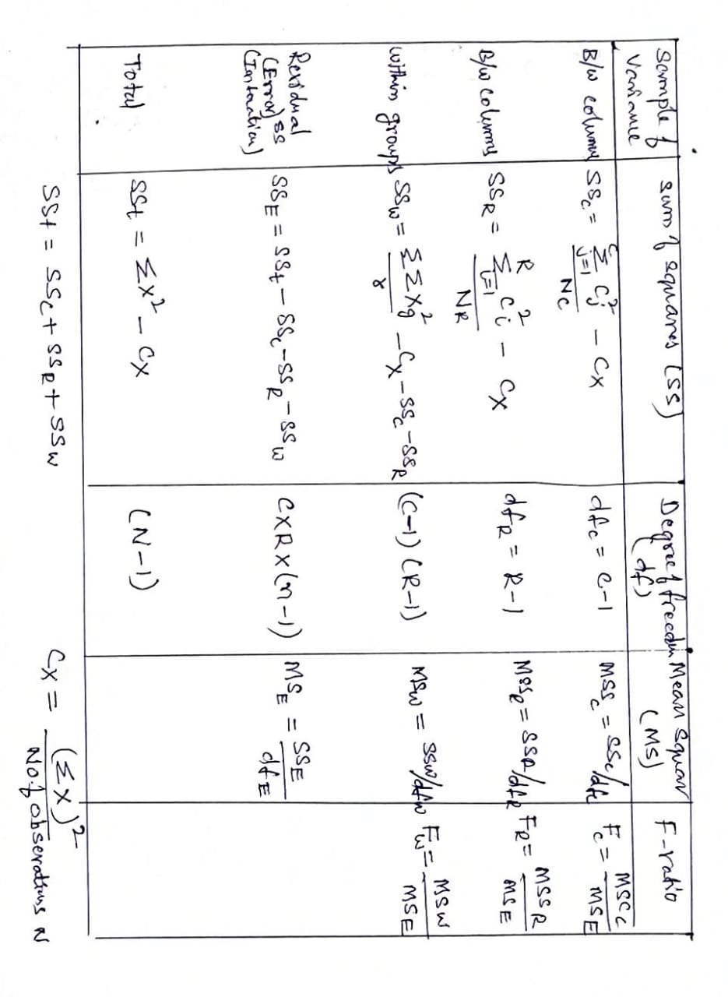
Two-way ANOVA- with replication formula

Slide 24
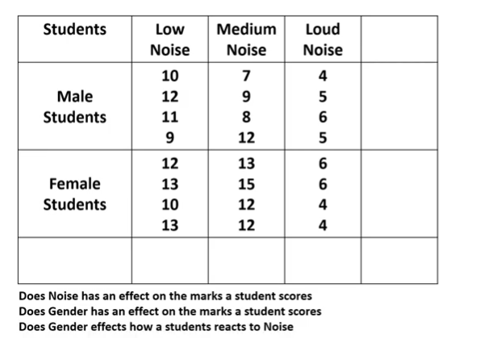
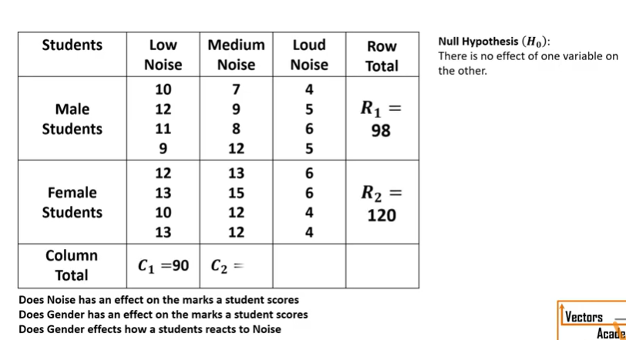
Two-way ANOVA with replication: Example 1
Consider the following sample of data

Slide 25
Example

Slide 26
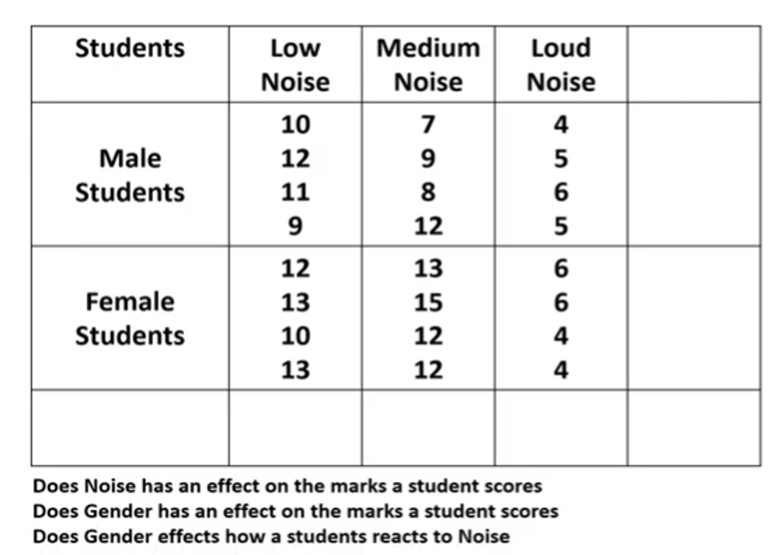
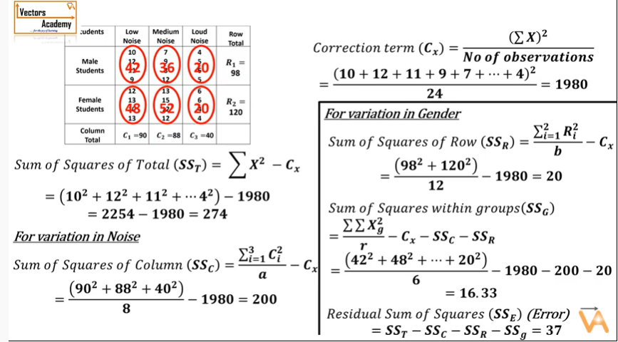
Example

Slide 27
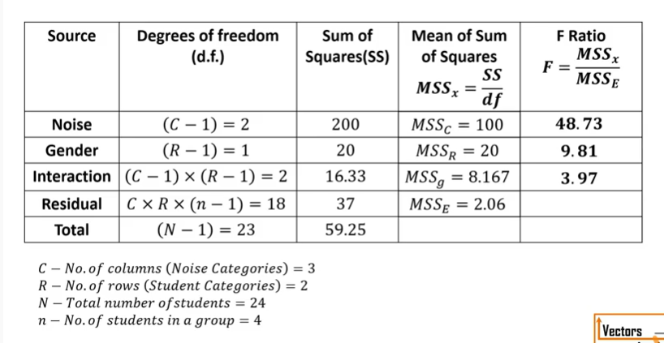
Example

Slide 28
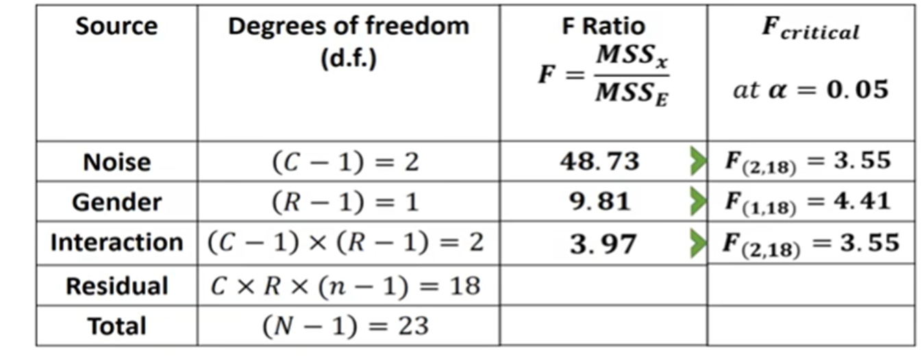
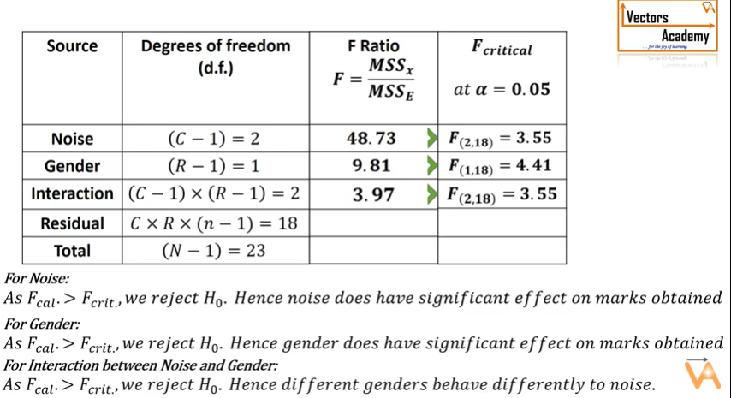
Example:

Slide 29
Two way anova with replication
Example 2 :set up anova table for the following information relating to the three drugs testing to judge the effectiveness in reducing blood pressure for three different groups of people
Drugs X Y Z
Group of people A | 14 15 | 10 9 | 11 11
B | 12 11 | 7 8 | 10 11
C | 10 11 | 11 11 | 8 7

Slide 30
Computation for two way anova with repeated values
Step (i) T = 187 , n = 18
Step (ii) correction factor = 187*187 /18
= 1942.72
Step(iii) SS between column (i.e between drugs)
= (73*73/6 + 56*56/6 + 58*58/6) - (187*187/18)
= 888.16 + 522.66 + 560.67 -1942.72
= 28.77

Slide 31
Step (iii) SS between rows (i.e between people)
= (70*70/6 + 59*59/6 + 58*58/6) – (187*187/18)
= 816.67 + 580.16 + 560.67 – 1942.72
= 14.78
Step(iv) total SS ={(14)² + (15)² + (12)² + (11)² +(10)² + (11)² +
(10)² + (9)² + (7)² + (8)² + (11)² + (11)² +
(11)² + (11)² + (10)² + (11)² + (8)² + (7)² – (187*187/18)
= 2019 -1942.72
= 76.28

Slide 32
Step (v) SS within samples
= (14-14.5)² + (15-14.5)²
+ (10-9.5)² + (9-9.5)² +
(11-11)² + (11-11)² + (12-11.5)² +(11-11.5)² +
(7-7.5)² + (8-7.5)² + (10 -10.5 )² + (11 – 10.5 )² +
( 10- 10.5)² + (11 -10.5 )² + (11 -11 ⁾² + (11- 11 )²
+ (8 – 7.5 )² + (7 – 7.5)² = 3.50
Step (vi) SS for interaction
= 76.28 - [28.77 + 14.78 + 3.50] = 29.23

Slide 33
Table :
The Anova Table
d.f. MS
Source of SS variation
F-ratio
5% F –
limit
Between column (i.e between drugs)
28.77
(3-1) = 2
28.77/2
= 14.385
14.385/ 0.389
= 36.9
F (2,9) = 4.26
Between rows (i.e between people)
14.78
(3-1) = 2
14.78 / 2
= 7.390
7.390/0.389
= 19.0
F (2,9) = 4.26
Interaction
29.23
4
29.23 / 4
= 7.308
7.308/0.389
= 18.786
F(4,9) = 3.63
Within sample errors.
3.50
(18- 9) = 9
Total
76.28
(18- 1)
= 17

Slide 34
The above table show that all the three f - ratio are significant of 5% level which means that
Conclusion
-the drugs act differently ,
-different groups of people are affected differently
-the interaction terms is significant

